Slide 1


ELG5901-EG00
Minimum Viable Prototype
Network optimization and analysis using AI
Group: AI_AWS3_MAY2022
Amir Safwat Halim Youssef
Abdulrahman Muhammad AbdulSalam Ahmed
Basma Reda Shaban Abd-Elsalam Abd-Elwahab
Ali Amin El-Sayed Mahmoud El-Sherif
Abdelrhman Gaber Youssef Saad Rezkallah
ID: 300327305
ID: 300327218
ID: 300327209
ID: 300327246
ID: 300327290

Slide 2
Table of contents
MVP -Ali El-Sherif – 300327246
Problem Definition
Potential Benefits to Sponsor/Users
Project Guidance
Screenshots
Critical Requirements 1
Solutions 1
Critical Requirements 2
Solutions 2
Critical Requirements 3
Solutions 3
Critical Requirements 4
Solutions 4
Critical Requirements 5
Solutions 5

Slide 3
Problem Definition
MVP -Ali El-Sherif – 300327246
Network failure detection and classification (the failure and its type) to provide lower maintenance cost and minimalize maintenance work.
5G network optimization using beamforming selection from lidar to increase data rate.

Slide 4
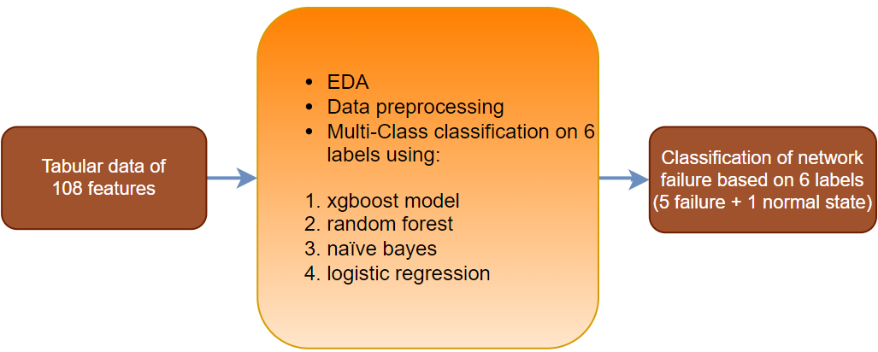
Problem Definition (Failure detection and classification)
MVP -Ali El-Sherif – 300327246
Failure detection and classification input and output

Slide 5
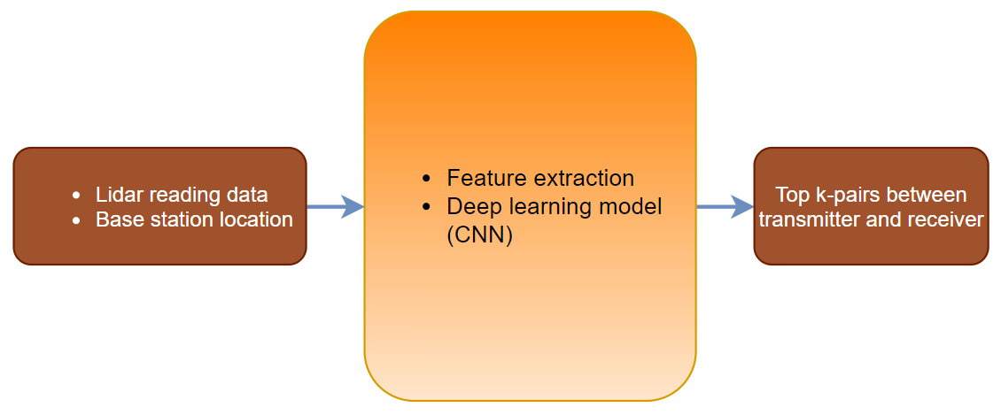
Problem Definition (5G network optimization)
MVP -Ali El-Sherif – 300327246
5G network optimization inputs and output

Slide 6
Potential Benefits to Sponsor/Users:
MVP -Ali El-Sherif – 300327246
AWS Private 5G is currently available in the following AWS Regions: US East (Ohio), US East (N. Virginia), and US West (Oregon).
AWS has a service category in augmented reality (AR) and virtual reality (VR) fields that require 5G technology.
Optimization of beam selection efficiency will lead to the increase of spectrum efficiency which is beneficial to the company, nevertheless, users can experience convenience through AWS or any other network applied to it.

Slide 7
Project Guidance:
MVP -Ali El-Sherif – 300327246
 | Amazon Web Services (Ahmed Elhamy) | Egypt Mentor (Dr. Anas Youssef) | uOttawa Supporter (Dr. Murat Simsek)
Linkedin | https://www.linkedin.com/in/ahmed-elhamy-13270296/ | https://www.linkedin.com/in/anas-youssef-62137370/ | https://www.linkedin.com/in/murat-simsek-32a7b220/

Slide 8
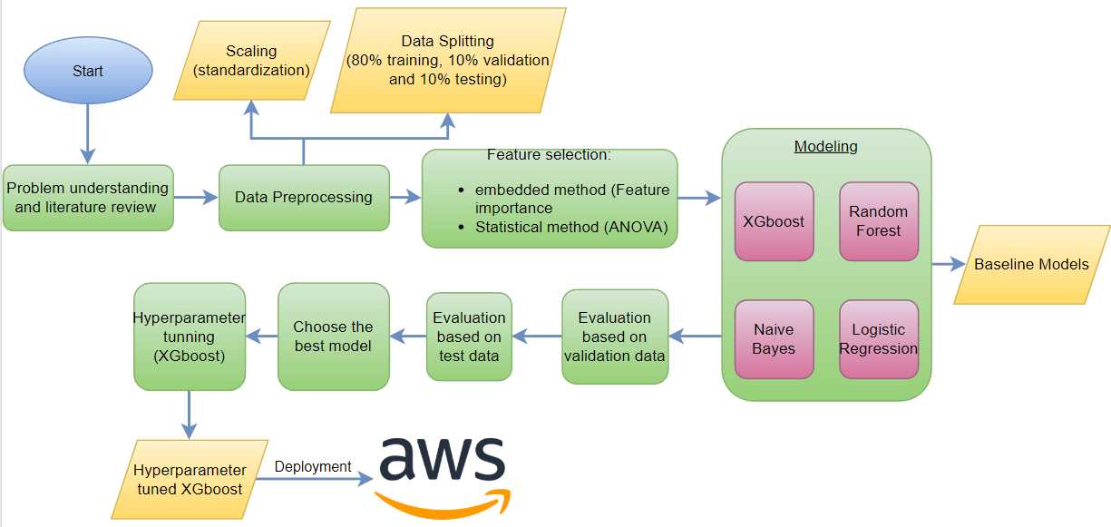
Project Walkthrough :
MVP -Ali El-Sherif – 300327246
Flow chart of failure detection and classification

Slide 9
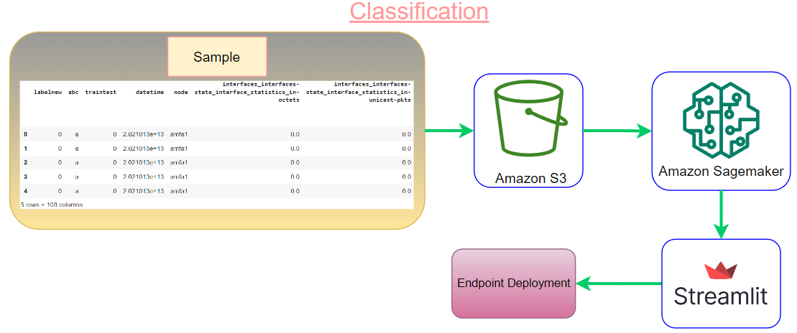
Deployment Architecture on AWS:
MVP -Ali El-Sherif – 300327246
Amazon Services used in classification

Slide 10
Critical requirements 1:
MVP -Ali El-Sherif – 300327246
Data Preprocessing
Deployment of multi class classification (in progress)
EDA

Slide 11
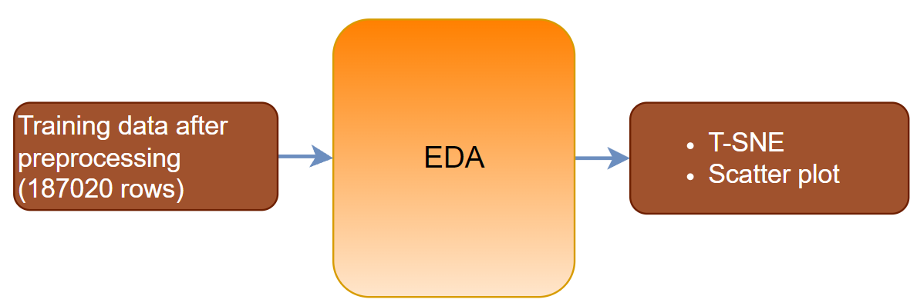
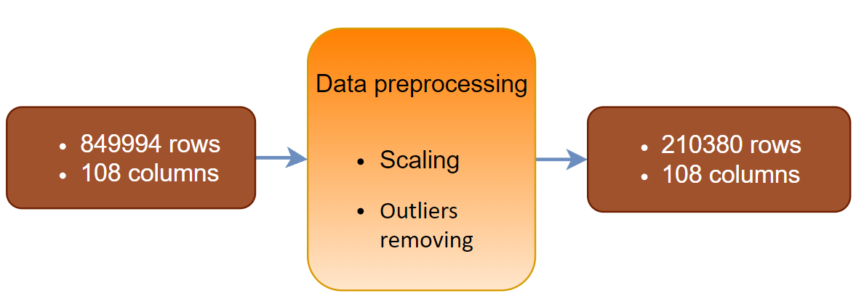
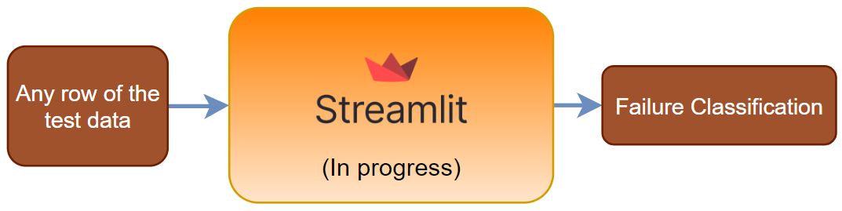
Solutions 1:
MVP -Ali El-Sherif – 300327246
T-SNE and scatter plot
Scaling and removing outliers
Failure classification through streamlit (in progress)

Slide 12
Critical requirements 2:
MVP-Basma Abd-Elwahab – 300327209
Building document based on Huawei description
EDA
Data preprocessing

Slide 13
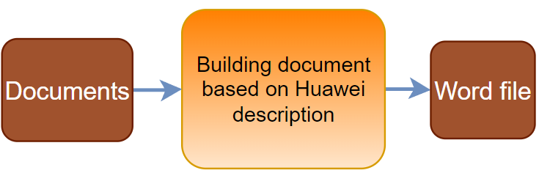
Solutions 2:
MVP-Basma Abd-Elwahab – 300327209
Literature review
T-SNE and scatter plot
Scaling and removing outliers

Slide 14
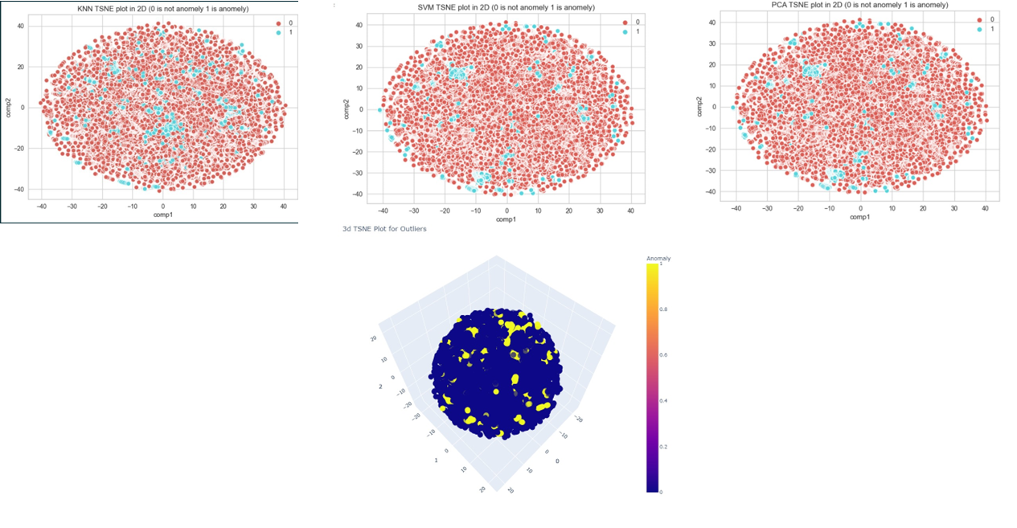
Screenshots:
MVP-Basma Abd-Elwahab – 300327209
2D and 3D T-SNE plots for binary class classification
Notes:
The problem was handled first as a binary class classification problem.
It was decided to make the problem more complex and realistic.

Slide 15
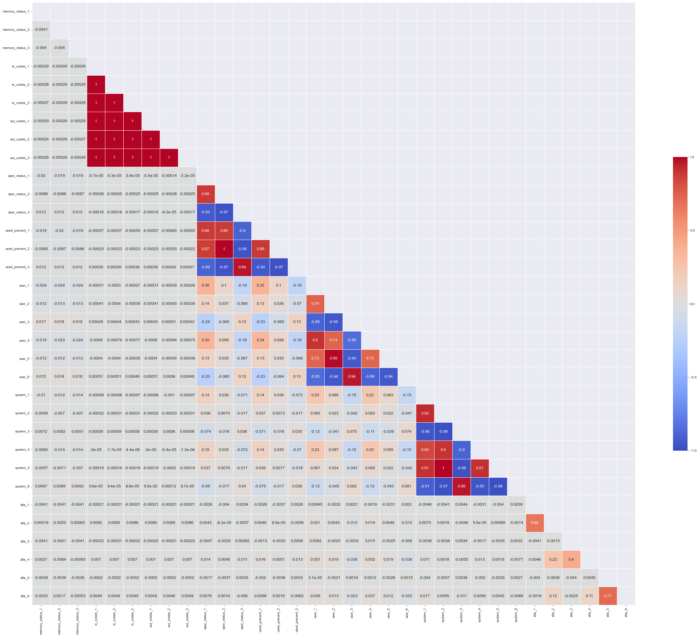
Screenshots:
MVP-Basma Abd-Elwahab – 300327209
Feature importance of selected features (33) in multi-class classification
Notes:
The problem was handled first as a binary class classification problem.
It was decided to make the problem more complex and realistic.

Slide 16
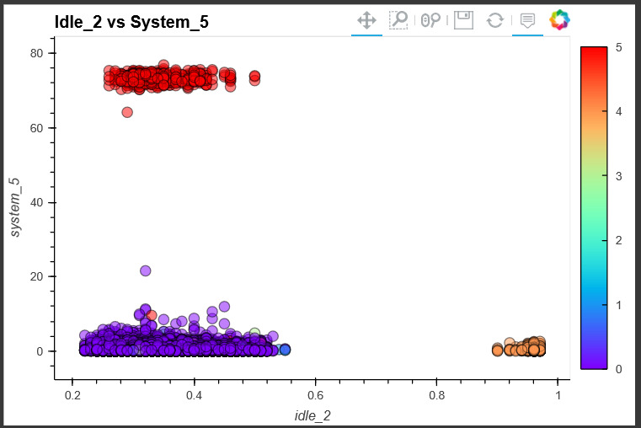
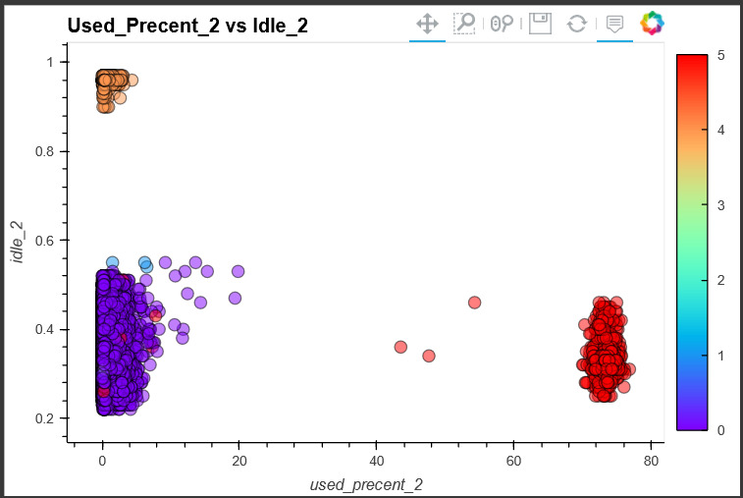
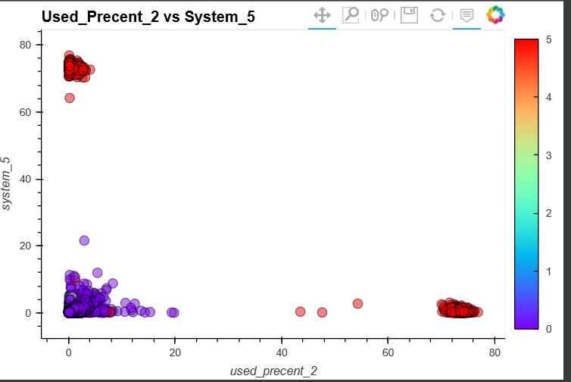
Screenshots:
MVP-Basma Abd-Elwahab – 300327209
Multi-class scatter plots for the data of 6 labels using any of the 33 features
Notes:
Linearly separable or not

Slide 17
Critical requirements 3 :
MVP-Amir Youssef – 300327305
Feature selection binary classification using filter method (ANOVA) and feature importance using embedded method
Searching in Huawei documents
Building document based on Huawei description

Slide 18
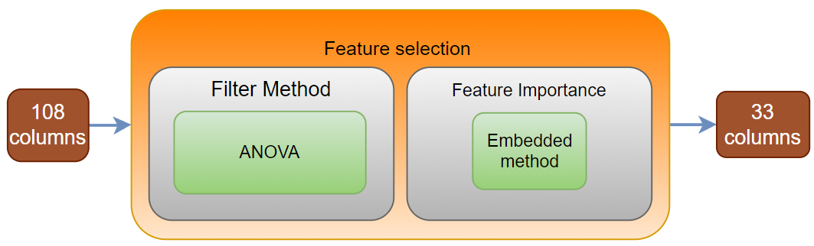
Solutions 3:
MVP-Amir Youssef – 300327305
Preparing documents for literature review Link
Literature review link
Feature selection

Slide 19
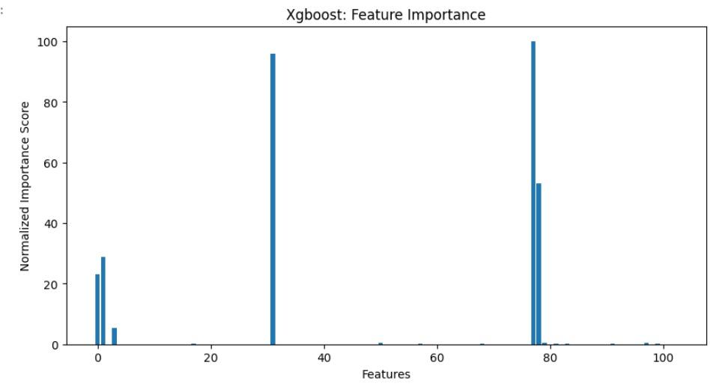
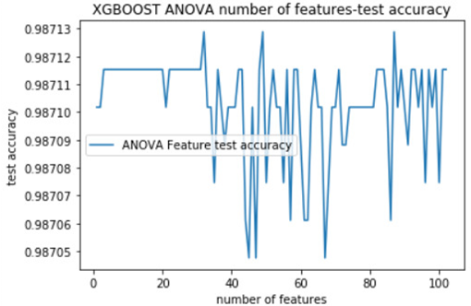
Screenshots:
MVP-Amir Youssef – 300327305
Feature importance according to XGBoost
Accuracies based on test data according to number of features
Notes:
The problem was handled first as a binary class classification problem.
It was decided to make the problem more complex and realistic.

Slide 20
Critical requirements 4:
MVP-Abdulrahman Ahmed – 300327218
Building baseline models
Selection of best performance model + Hyperparameter Tuning (Will be used in deployment)
Models Evaluation

Slide 21
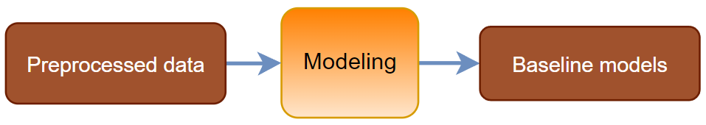
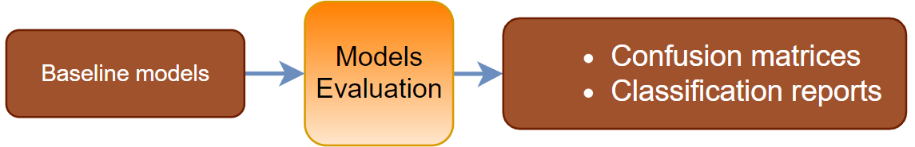
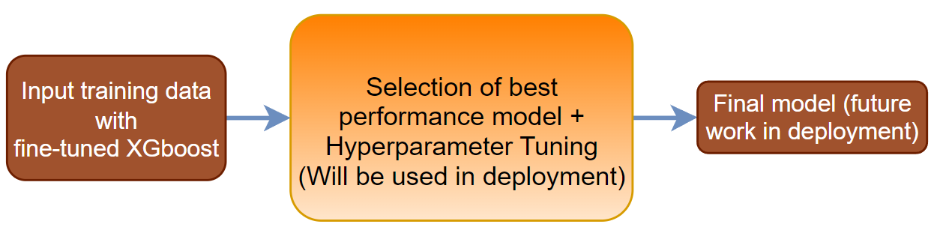
Solutions 4:
MVP-Abdulrahman Ahmed – 300327218
Modeling to produce baseline models
Evaluation based on confusion matrices and classification reports
Hyperparameter tuning of the champion model

Slide 22
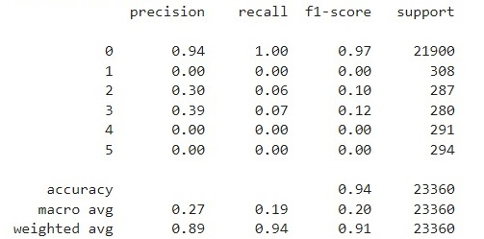
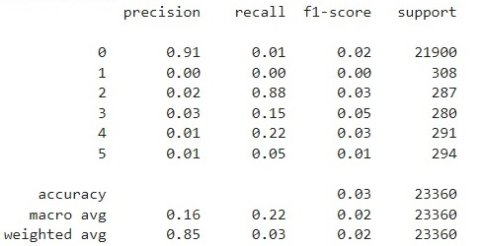
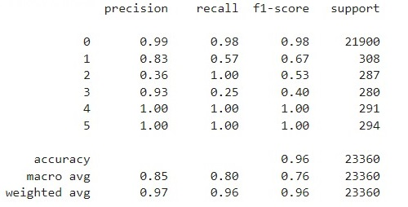
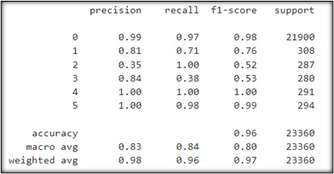
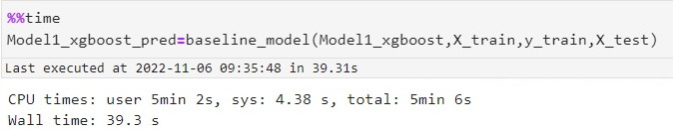
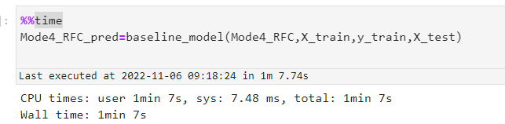
Screenshots:
MVP-Abdulrahman Ahmed – 300327218
Classification report (F1 Score)
Logistic regression
naive bayes
Random Forest
xgboost
Testing time of RF
Testing time of xgboost

Slide 23
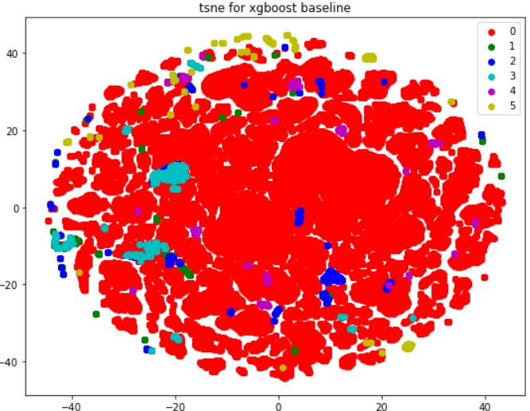
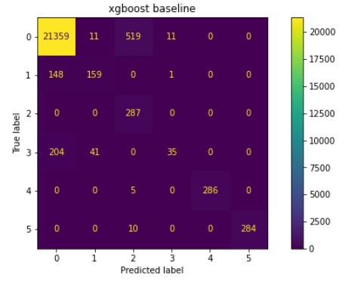
Screenshots:
MVP-Abdulrahman Ahmed – 300327218
Classification report of XGboost
Confusion Matrix of XGboost model (multi-class classification)
T-SNE of XGboost

Slide 24
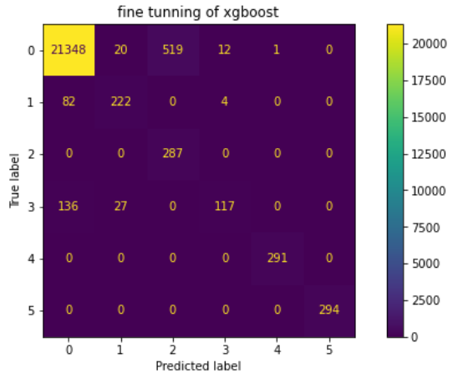
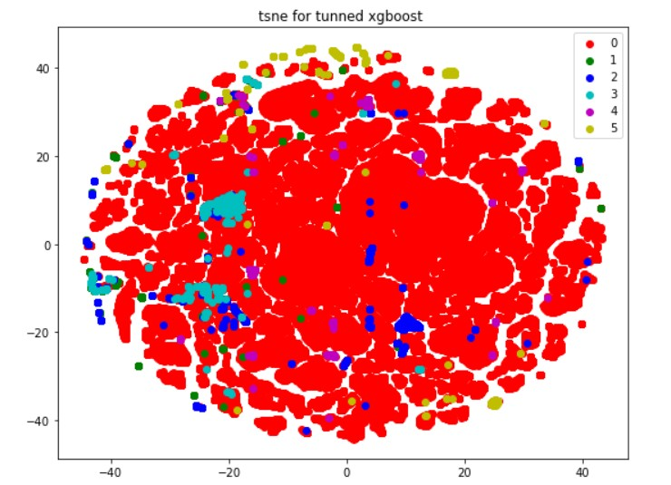
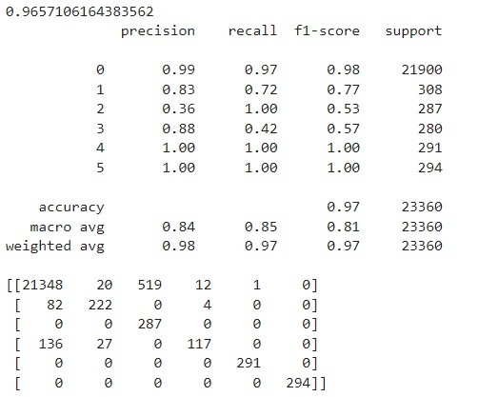
MVP-Abdulrahman Ahmed – 300327218
Screenshots:
Confusion Matrix of fine tuned XGboost model (multi-class classification)
Classification report of fine tuned XGboost
T-SNE of fine tuned XGboost

Slide 25
Critical requirements 5:
MVP-Abdelrhman Rezkallah – 300327290
Trying time series model using LSTM
Studying the main reasons resulting network failure
Deployment of multi class classification on AWS (in progress)

Slide 26
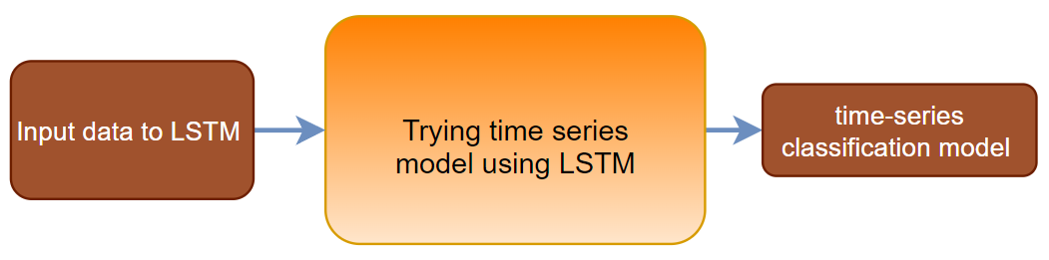
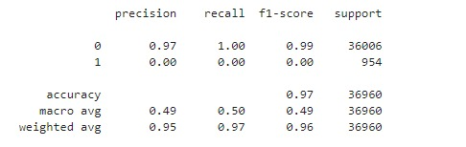
Solutions 5:
MVP-Abdelrhman Rezkallah – 300327290
Time series modeling
Literature review
Failure classification through Streamlit(in progress)
Classification report of time-series model

Slide 27
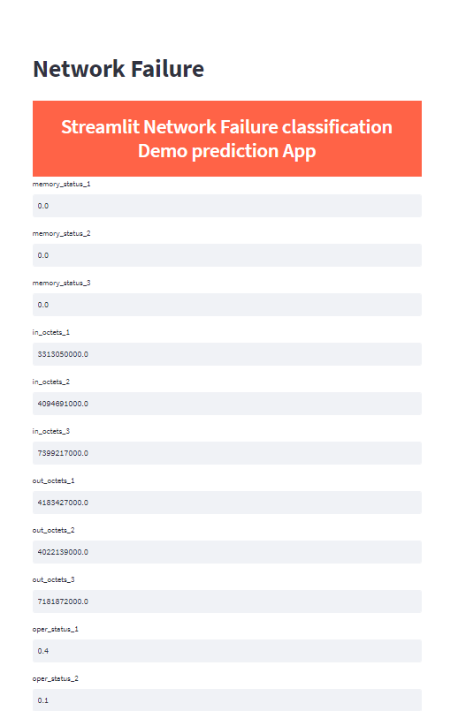

Screenshots:
MVP-Abdelrhman Rezkallah – 300327290
Deployment Link

Slide 28
Future work
MVP-Abdelrhman Rezkallah – 300327290
Check model stability.
Deployment AWS service Failure classification through Streamlit(in progress)
Start network optimization Beam forming selection.

Slide 29
Thank You

